Slide 1
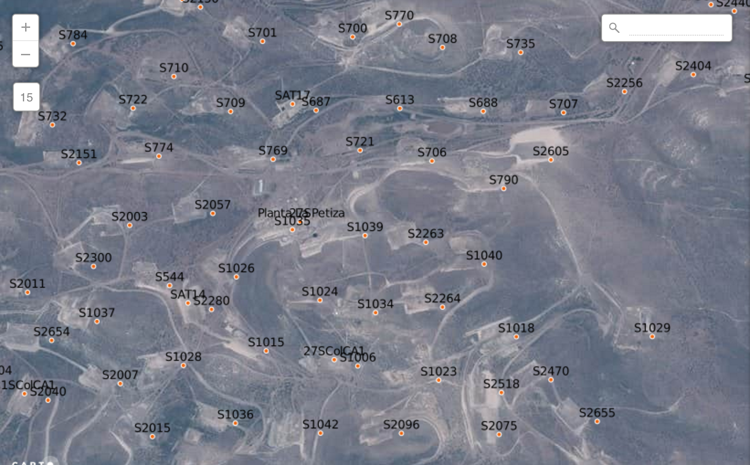
Example Scorecard
Revenue
ROI
Costs
Accidents
Costs per oil well
$ 11.3 M
3%
$ 7.3 M
0
Revenue per oil well
Revenue per oil well
Revenue per oil well

